Slide 1



SOFTWARE DEVELOPMENT PROFESSIONAL PROGRAM
Starting a Web Server

Slide 2





Starting a Web Server
Learning Objectives
Describe what a core module is.
Create a simple web server using the HTTP core module.
Globally install the nodemon module to assist in development.

Slide 3

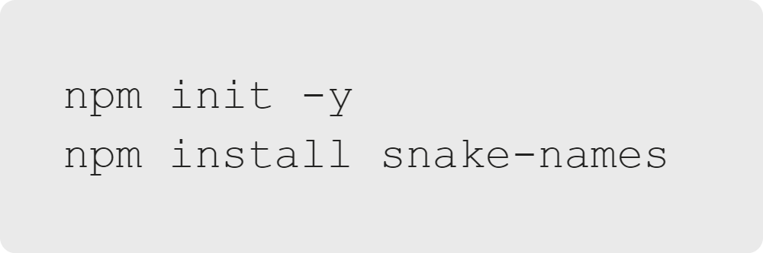

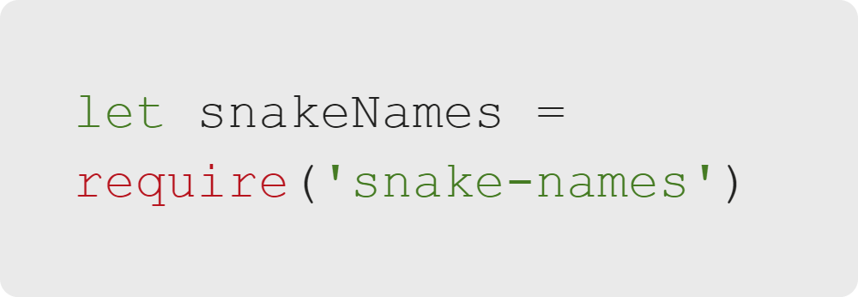
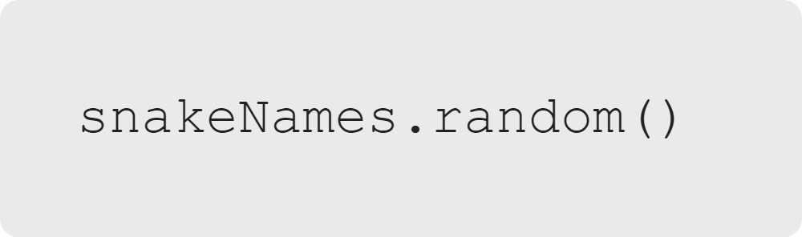
Starting a Web Server
Node Modules: Review
Install It
Require It
Use It
Notes:
We recently learned how to use a node module in our code. Let's briefly review the process

Slide 4

Starting a Web Server
Node.js Core Modules
These built-in modules contain essential functionality and do not need to be installed.
Notes:
<< Reference: https://www.tutorialsteacher.com/nodejs/nodejs-modules >>

Slide 5
Starting a Web Server
Important Core Modules
Module Name | Description / Usage
http | Creating web servers
url | Methods for URL parsing
path | Methods for parsing file paths
fs | Methods for dealing with file I/O
See the full list on the W3Schools website.
Notes:
While not an exhaustive list, here are a few common built-in modules you might encounter. In particular, "fs" can
help you read from or write to files on your local machine.

Slide 6

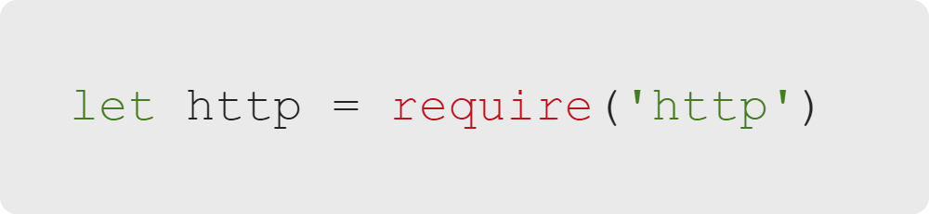
Starting a Web Server
HTTP Module: Step 1
Let's use the HTTP module in our code.
We must still utilize the require method for core modules.
Notes:
The HTTP module returns its functionality when you require it.

Slide 7
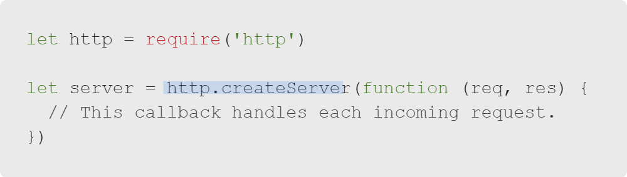
Starting a Web Server
HTTP Module: Step 2
We can employ the HTTP module to create a web server.
Use the createServer method.
Notes:
The "createServer" method creates and returns a server object.

Slide 8
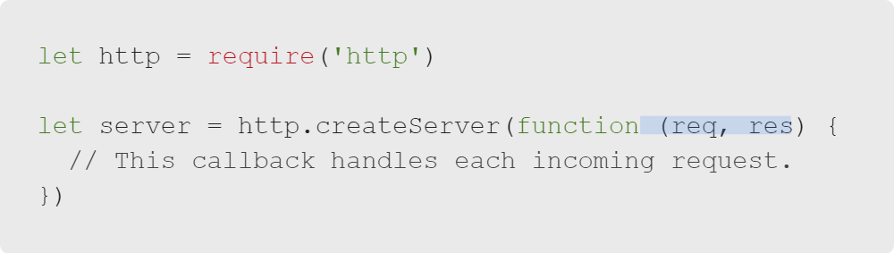
Starting a Web Server
Definitions
Let's take a closer look at the code.
req: The HTTP Request
res: The HTTP Response
Callback function: Runs when a client connects to the server
Notes:
<< Take a moment to ensure learners are following along >>

Slide 9
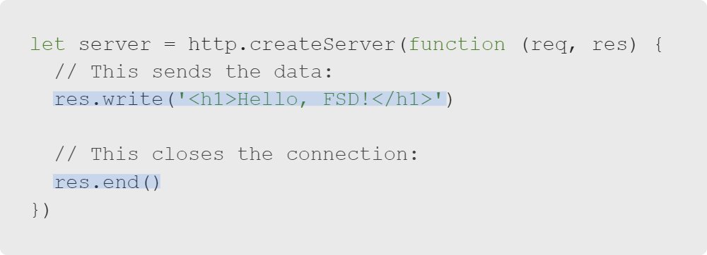
Starting a Web Server
HTTP Module: Step 3
The server must respond to the client by sending data with the response.
Then, we will close the connection.
Use the write and end methods.
Notes:
The "createServer" method creates and returns a server object.
Question: Why do we need to call the "res.end()" method?
Answer: The response is a writeable stream. This means we could keep calling "res.write()" to send more data.
The "res.end()" method lets the client know that no more data is coming from our end.

Slide 10
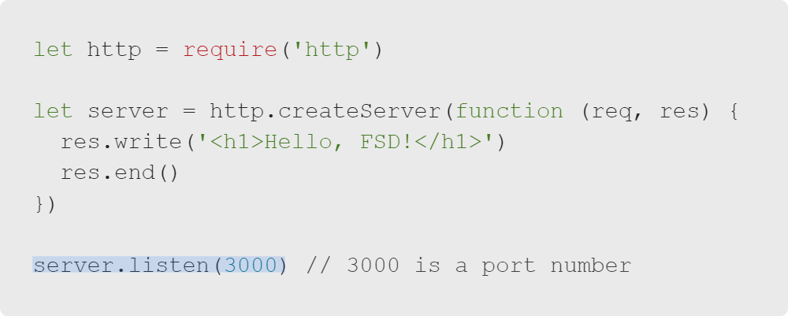
Starting a Web Server
HTTP Module: Step 4
Web servers are always running and waiting for connections.
We can use the listen method to watch for connections.
Notes:
In this example, 3000 is a port number. It means the server will run on port 3000 of whatever machine is used.

Slide 11

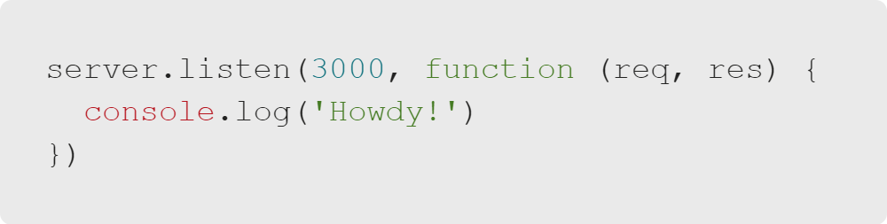
Starting a Web Server
Quiz: Web Servers
When and where will the log message appear?
A. In the terminal when the server starts
B. In the browser's Console tab when the server starts
C. In the terminal when someone connects
D. In the browser's Console tab when someone connects
Notes:
The above code is valid. This isn't a trick question!

Slide 12
Starting a Web Server
Quiz: Web Servers
When and where will the log message appear?
✅ A. In the terminal when the server starts
🚫 B. In the browser's Console tab when the server starts
🚫 C. In the terminal when someone connects
🚫 D. In the browser's Console tab when someone connects

Slide 13
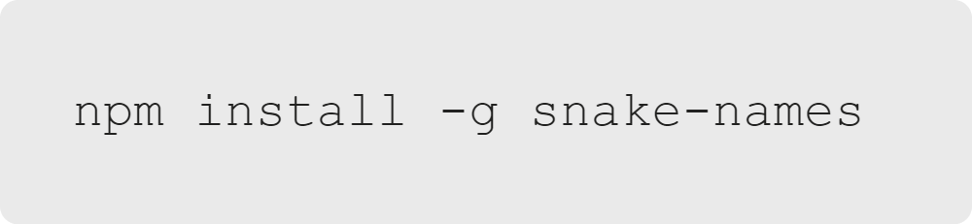
Starting a Web Server
Global npm Installs
If you need to use snake-names frequently, you could install it globally:
Global installation is an option when using npm.
Global installation means the package will be available across your entire machine.
Notes:
The code snippet shows how to install "snake-names" globally. (You may remember directions for this in the docs.)

Slide 14
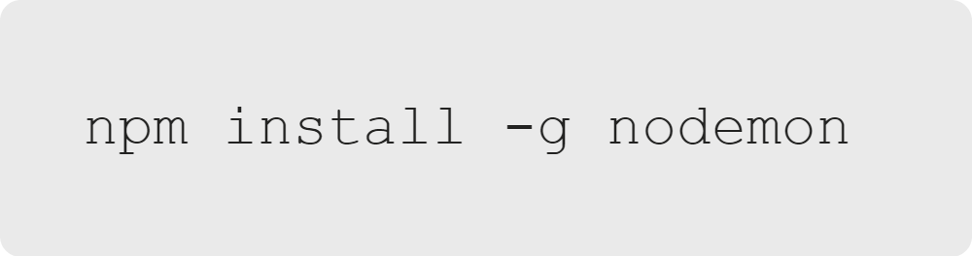
Starting a Web Server
Global Installation
Typically, you do not want to install something globally.
The exception to the rule is if you have a tool you like to use during development.
Does anyone know what this nodemon does?
Notes:
<< Ask the class if anyone is familiar with "nodemon," which will lead into the next slide >>

Slide 15

Starting a Web Server
Benefits of Nodemon
Nodemon monitors your code for changes and automatically restarts your server as needed.
We will install nodemon during the activity. This will save you lots of time.
From: npm

Slide 16

Starting a Web Server
What Are We Waiting For?
Let's do it!
Notes:
For many of us, this will be our very first web server. Let's do it!

